Slide 1
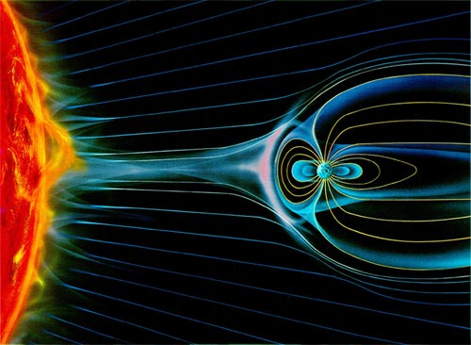
Electromagnetic Field
Simulation
Neil Edelman
Dan Smilowitz
Muhamed Razalee Yusoff
Olivier Shelbaya

Slide 2
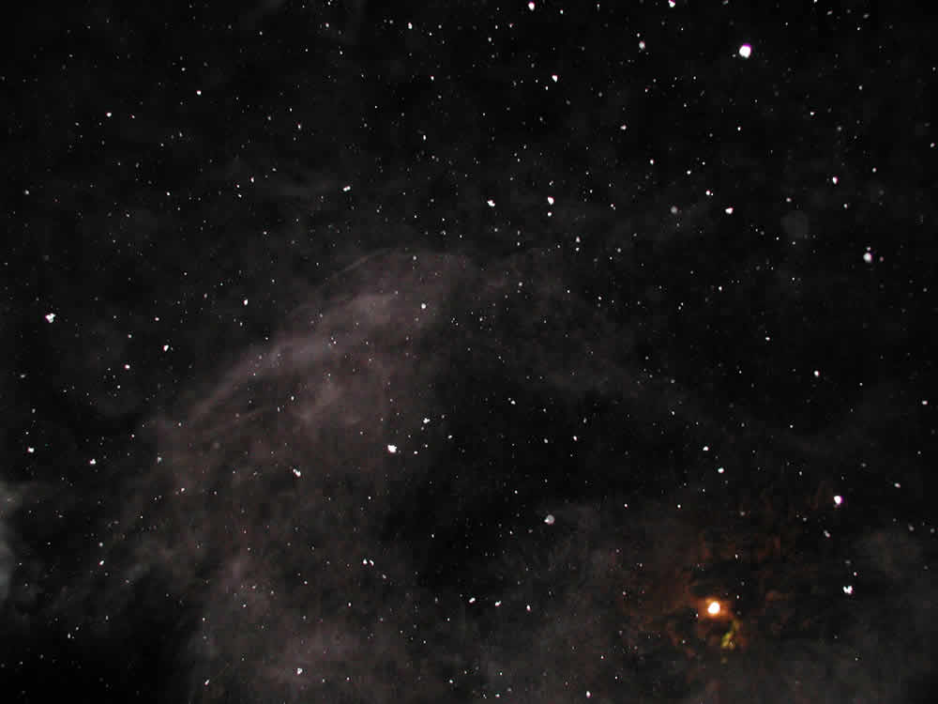
Step 1: Empty Space
Space has a magnetic permeability of μ₀
An area with no objects is shown
There are no magnetic or electric fields because space is isotropic

Slide 3
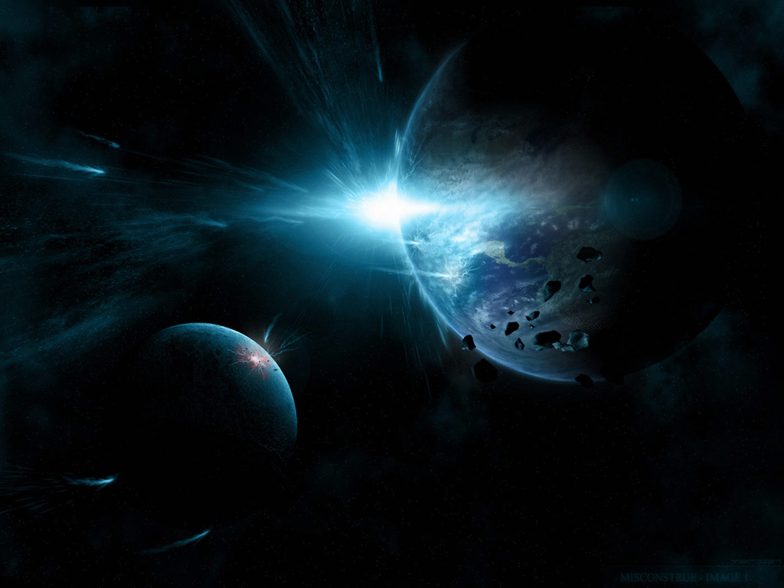
Step 2: Planet
A planet is generated
  The planet has a magma core
  The rest of the planet is composed of olivine
    Olivine is the average material composition of Earth aside from its core
The core of the Planet can be modeled by a giant current loop
The magnetic field is calculated from modeled current loops

Slide 4
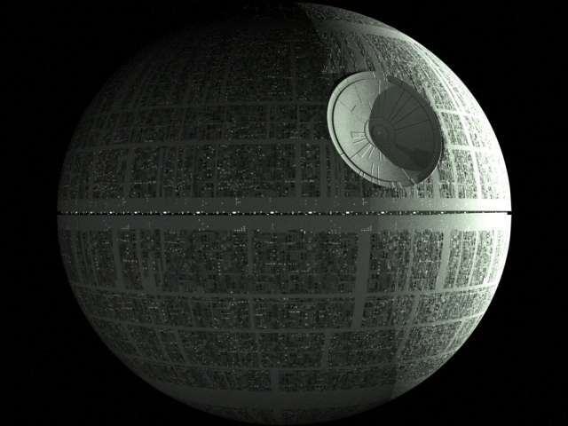
Step 3: Death Star
The Death Star is now generated
  It is composed of entirely iron
It does not generate a magnetic field
The magnetic field due to the presence of the planet propagates through the Death Star
  The Death Star has a magnetic permeability of μ_{Fe}

Slide 5
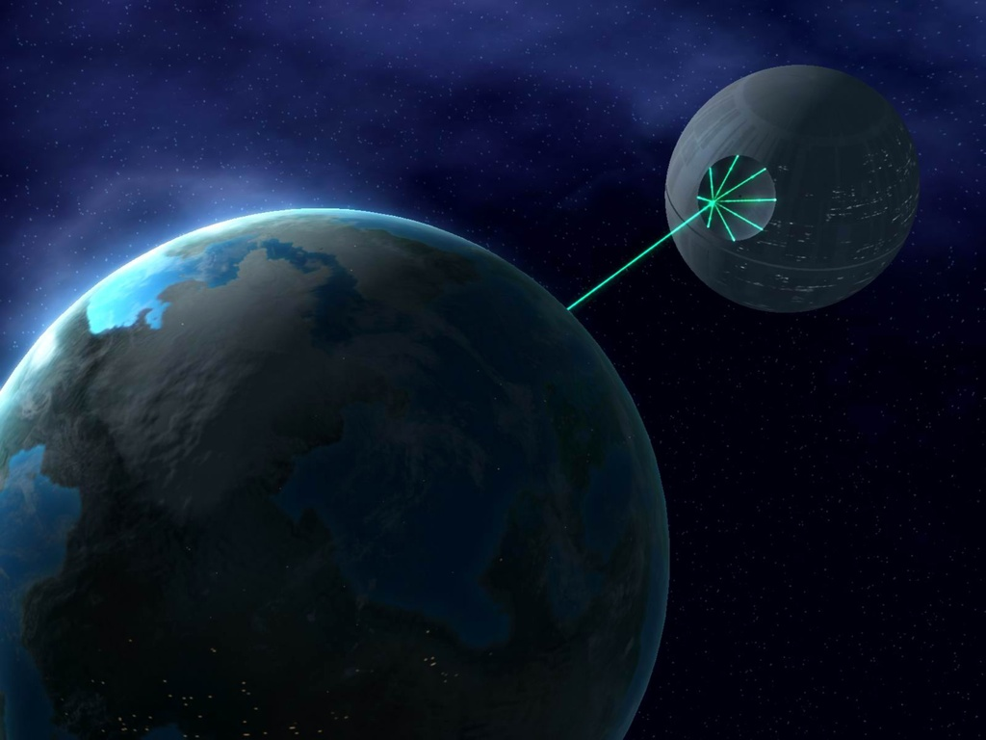
Step 4: Positron Beam from
Death Star to Planet
A beam of positrons passes from the Death Star to the planet.
  This corresponds to a current of positive charges
The positron beam generates its own electric and magnetic fields (by the right-hand rule)
  These new fields are also induced in the planet and the Death Star

Slide 6
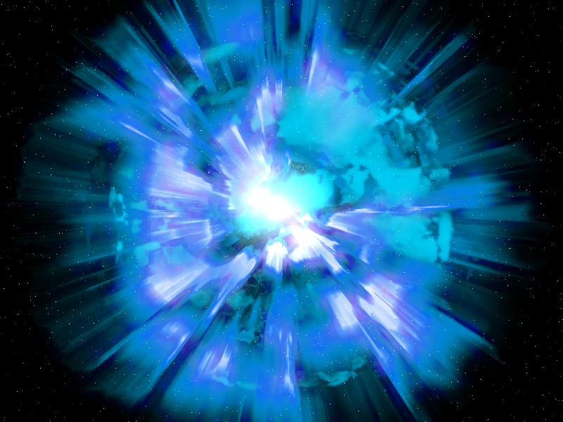
Step 5: Explosion
After the beam strikes the planet, the planet explodes
The planet is reduced to plasma, which is dispersed into space
We have employed the Gauss-Seidel technique, which is used to solve linear system of equations

